Slide 1
All You Ever Wanted to Know About Dynamic Taint Analysis and Forward Symbolic Execution (but might have been afraid to ask)
Edward J. Schwartz, Thanassis Avgerinos, David Brumley
Carnegie Mellon University Pittsburgh, PA
Presented by
Ravi Rajpurohit
Shovon Niverd Pereira

Slide 2
Introduction
Dynamic analysis is the analysis of the properties of a running program[1].
Deals with actual program execution
Perform precise security analysis
Considers single execution at a time

Slide 3
The paper talks about two popular dynamic analysis techniques
Dynamic analysis
Dynamic taint analysis
Forward symbolic execution

Slide 4
Goals and Contribution
Formalize dynamic taint analysis and forward symbolic execution
Describe
Common implementation detail
Caveats
Choices in various security applications

Slide 5
Applications
Unknown Vulnerability Detection
Automatic Input Filter Generation
Malware Analysis
Test Case Generation

Slide 6
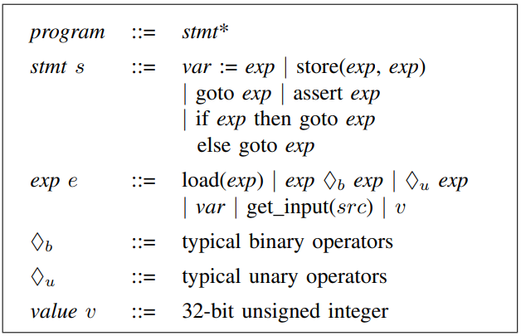
A general language (SimpIL)
[2, Figure 1] Grammar for SimpIL

Slide 7
SimpIL
Statements
Assignments
Assertions
Jumps/conditional jumps
Expressions
Constants and variables evaluate to 32-bit integer
Binary operators
Operands are integer or variables
Unary operators
Well-typed

Slide 8
Dynamic Taint Analysis
T = indicates tainted data
F = indicates untainted data
Source
Sink
Track information flow

Slide 9
Dynamic Taint policies
Taint Introduction
Taint can be introduced in any kind of data source
Taint Propagation
Propagation rules specify the taint data from tainted or untainted operands
Tainted data
assignments
binary
unary
Jump
Condition check
………
getInput()
T|F
T|F
T|F
Tainted data
T|F
T|F
Program
T|F

Slide 10
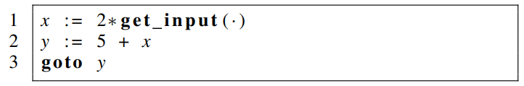
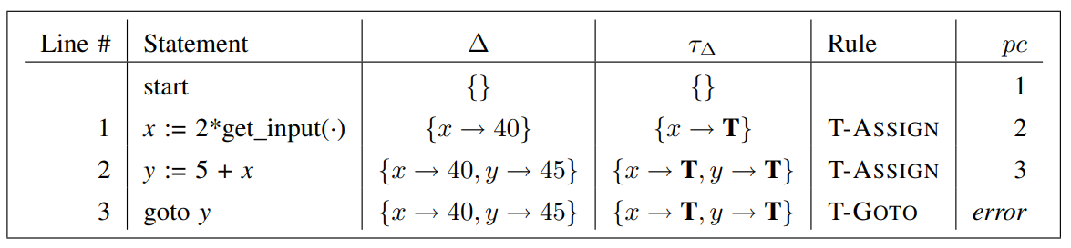
Dynamic Taint policies
Taint checking: example shows no goto instruction will take a tainted value for jump destination,
Example of tainted jump policy
[2, Figure 2] Taint checking for a given program in SimpIL

Slide 11
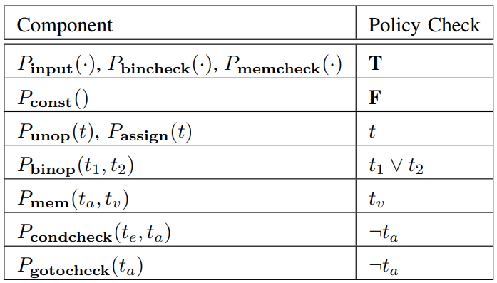
[2, Figure 3] Policy for tainted jump

Slide 12
Different policy for different application
Previous policy does not consider what if a memory address is tainted
MIGHT MISS SOME ATTACKS!!

Slide 13
Challenges
Tainted addresses
Undertainting
Overtainting
Time of detection vs time of attack

Slide 14
Sanitization
Untaint value(avoid taint spread)
Constant functions e.g. b = a xor a
Application specific

Slide 15

Control Flow taint
[2, Figure 4] Control flow taint example
Pure taint analysis cannot compute control dependencies
Alternative: Additional static analysis
Use heuristics

Slide 16

Forward Symbolic Execution
Output 1
Input 1
Systematically explores all possible execution paths of a program
Represents unknown inputs as symbolic values
Provides insights into how different inputs might affect the program's behavior
Output 2
Input 2
Program
Input 3
Output 3

Slide 17
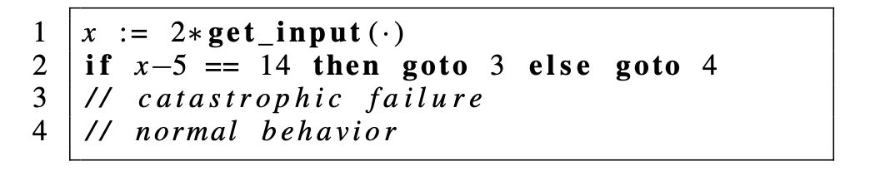
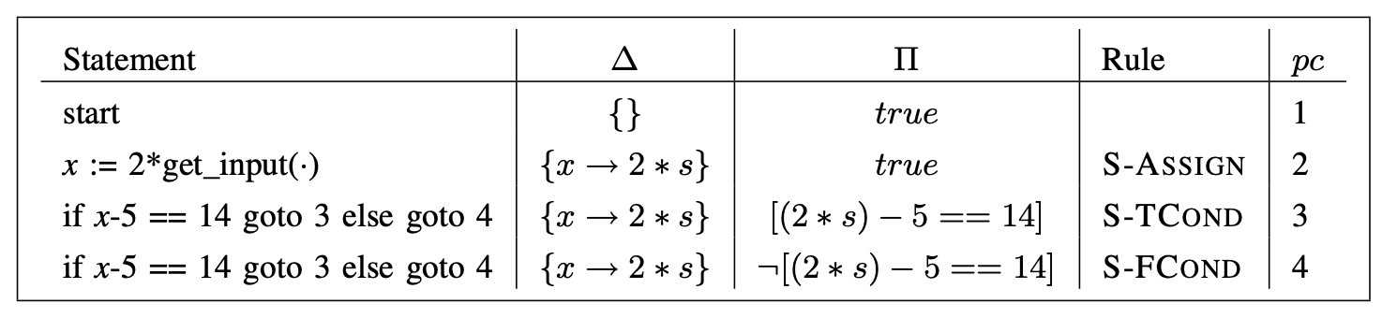
Example
Program
Lets look at a simple program and the forward symbolic execution
Working
[2, Figure 5] Forward Symbolic Execution for a given program in SimpIL

Slide 18
Related works
Formalization
The paper acknowledges that -
Other attempts to formalize dynamic security mechanisms exist[3]
But dynamic taint analysis and forward symbolic execution is largely avoided
Similar programming language is also defined[4] but lacks clarity and formal semantics

Slide 19
Related works
Applications
FSE – Forward Symbolic Execution
DTA – Dynamic Taint Analysis
Automatic Test Case Generation
Web Applications
Automatic Filter Generation
Understand
Automatic Network Protocol
FSE for assertion errors, divide by zero, null pointer dereferences etc.
FSE used to detect inputs that trigger known bugs and vulnerabilities
DTA to understand network protocol behaviors
DTA for common attacks like SQL injection

Slide 20
Conclusion
In a gist, the paper talks about the following points
Popularity of Dynamic Program Analysis in Security – Both Dynamic Taint Analysis and Forward Symbolic Execution are highly popular and extensively used
Lack of formal definitions and issue summaries – Absence of formal definitions and comprehensive summary of implementation issues
Contributions of the research – Introduced a language SimpIL to define operational semantics
Challenges and Tradeoffs – Shed the light on challenges, techniques, and tradeoffs
SimpIL helps formalize the techniques but more information on extending it to regular languages could make the paper complete
Operational semantics of the policies could be helped with more robust explanation

Slide 21
References
[1] Ball, Thoms. "The concept of dynamic analysis." ACM SIGSOFT Software Engineering Notes 24.6 (1999): 216-234.
[2] E. J. Schwartz, T. Avgerinos and D. Brumley, "All You Ever Wanted to Know about Dynamic Taint Analysis and Forward Symbolic Execution (but Might Have Been Afraid to Ask)," 2010 IEEE Symposium on Security and Privacy, Oakland, CA, USA, 2010, pp. 317-331, doi: 10.1109/SP.2010.26.
[3] Fred B. Schneider. Enforceable security policies. ACM Transactions on Information and System Security, 3(1):30– 50, February 2000.
[4] Patrice Godefroid, Nils Klarlund, and Koushik Sen. DART: Directed automated random testing. In Proceedings of the ACM Conference on Programming Language Design and Implementation, 2005.

